Slide 1
Vibrio cholerae
Mrs Mamita Rai Gurung

Slide 2
General characteristics
a member of the family Vibrionaceae, facultatively anaerobic, Gram-negative, non-spore-forming curved rod, about 1.4–2.6mm long.
Highly motile with a single polar flagellam.
V. cholerae has a low tolerance for acid, but grows under alkaline (pH 8.0 to 9.5) conditions that inhibit many other Gram-negative bacteria.
oxidase positive, reduces nitrate
More than 30 species of Vibrios.
Vibrios of Medical importance:
V cholerae V mimicus
V parahemolyticus V vulnificus

Slide 3
Contd...
Grows in salt and fresh water
Can survive and multiply in brackish water by infecting copepods
Causative agent of Cholera

Slide 4

Cholera
A life-threatening secretory diarrhea induced by enterotoxin secreted by V. cholerae
Water-borne illness caused by ingesting water/food contaminated by copepods infected by V. cholerae
A major epidemic disease

Slide 5
Transmission
Transmitted by fecal-oral route
Contaminated food or water
  Inadequate sewage treatment
  Lack of water treatment
  Improperly cooked shellfish
Feces of infected person contaminates water supply
Resulting diarrhea makes it easy for bacteria to spread in unsanitary conditions

Slide 6
Filipo Pacini(Discovery)
1854: identified comma-shaped bacterium
Named it Vibrio cholerae

Slide 7
Antigenic structure
Flagellar antigen-H antigen
Somatic antigen-O antigen
O lipopolysaccharide confers serologic specificity
More than 150 O antigen serogroups
Only the O1 and O139 serogroups produce cholera toxin and cause the most severe form of cholera.
The O1 serogroup is further subdivided into serotypes (Inaba, Ogawa, and Hikojima) and biotypes (classical and el tor)

Slide 8
O1
    Classical: 1 case per 30-100 infections
    El Tor: 1 case per 2-4 infections
O139
    Contained in India, Bangladesh

Slide 9
Virulence factors
Cholera toxin
Zot toxin
Ace toxin
OI and O139 somatic antigens
Hemolysins/cytotoxins
Flagellum
Mucinase
TCP pilli (Toxin coregulated pilli)

Slide 10
Virulence factors of V.cholerae O1 and O139
Virulence factor | Biological effect
Cholera toxin | Hypersecretic of electrolytes and water
Coregulated pilus | Adherence to mucosal cells adhesin
Accessory colonization factor | adhesin
Hemagglutination protease | Releases bacteria from mucosal cells
Zona occludens(Zot toxin) | Exotoxin
Accessory cholera enterotoxin(ACE toxin) | Exotoxin
Flagellum | Motility
Siderophores | Iron sequestration

Slide 11
Vibrio cholerae-Clinical manifestations
  Asymptomatic colonization to fatal diarrhea
  Onset 2-3 days after ingestion
  Abrupt onset of watery diarrhea and vomiting
  Rice water stools
  Severe fluid and electrolyte loss dehydration, metabolic acidosis, hypovolemic shock, renal failure
  Death 60% if untreated, 1% if treated for fluid loss

Slide 12
Sign and symptom
10⁶-10¹¹ colony-forming units
Occur 2-3 days after consumption of contaminated food/water
Vomiting
Cramps
Watery diarrhea (1L/hour)
Without treatment, death in 18 hours-several days

Slide 13
Contd....
More severe symptoms
Rapid loss of body fluids
    6 liters/hour
    10⁷ vibrios/mL
Rapidly lose more than 10% of bodyweight
Dehydration and shock
Death within 12 hours or less
Death can also occur within 2-3 hours

Slide 14
Pathogenicity
Infection due to V. cholerae begins with the ingestion of contaminated water or food.
After passage through the acid barrier of the stomach, the organism colonizes the epithelium of the small intestine by means of the toxin-coregulated pili and possibly other colonization factors such as the different haemagglutinins, accessory colonization factor, and core-encoded pilus, all of which are thought to play a role.
Cholera enterotoxin produced by the adherent vibrios is secreted across the bacterial outer membrane into the extracellular environment and disrupts ion transport by intestinal epithelial cells.
The subsequent loss of water and electrolytes leads to the severe diarrhoea characteristic of cholera.

Slide 15
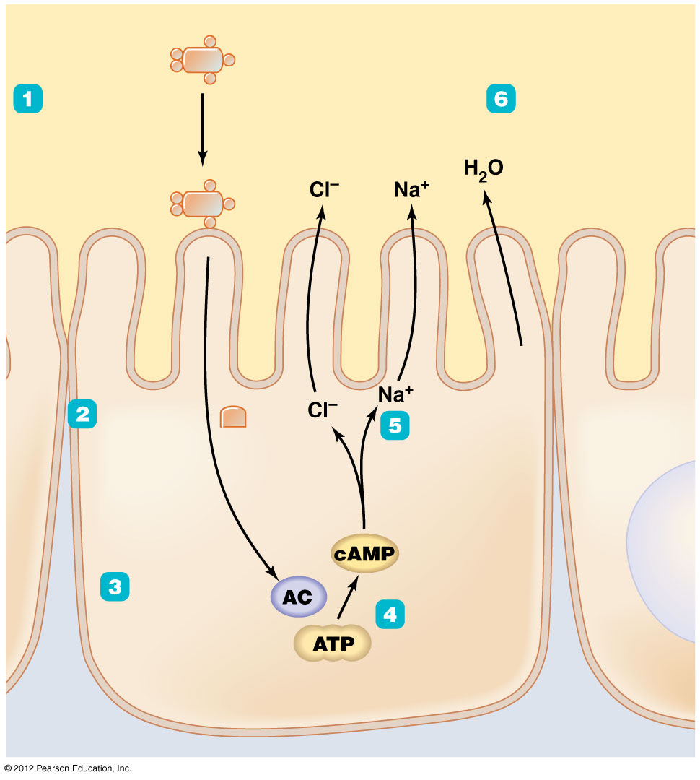
The action of cholera toxin in intestinal epithelial cells

Slide 16
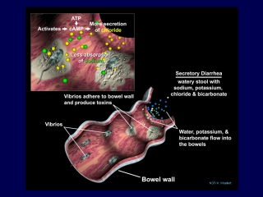

Slide 17
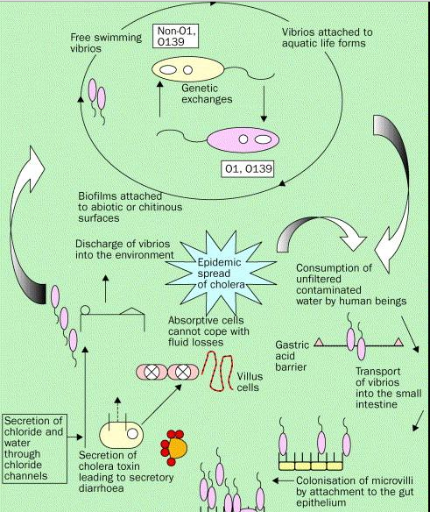
Life cycle of vibrio

Slide 18
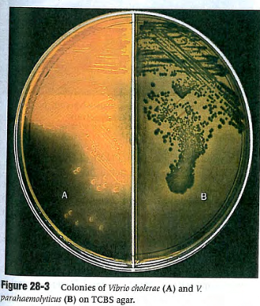
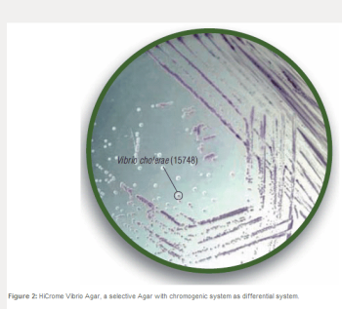
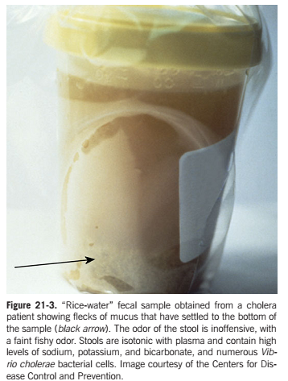
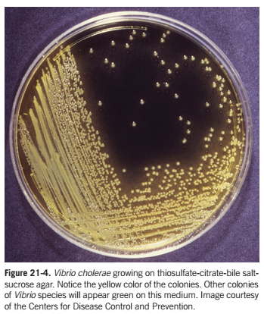
Lab diagnosis

Slide 19
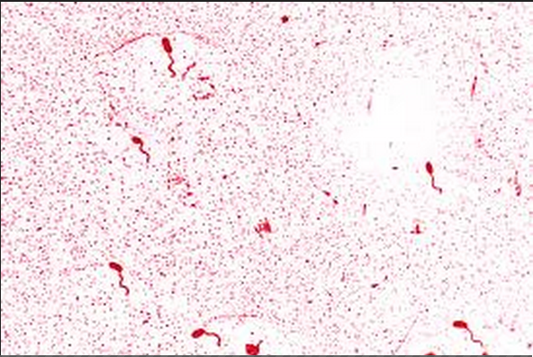
Sample :- Stool
Macroscopic analysis-Rice water stool
Microscopy
Gram negative, straight or slightly curved rods.
In stool specimen from cholera patients, rapid darting or shooting-star motility of Vibrio can be observed
Fllagelar staining

Slide 20
Culture
In BA, medium to large smooth opaque colonies are seen, can be beta hemolytic.
In MA, NLF colonies are seen i.e white to colorless colonies (except V vulnificus)
Thiosulphate Citrate Bile Salt(TCBS)- yellow colony

Slide 21
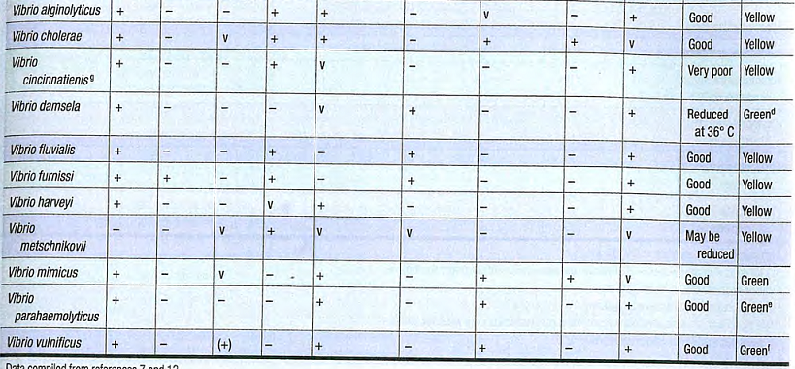
BIOCHEMICAL TEST

Slide 22
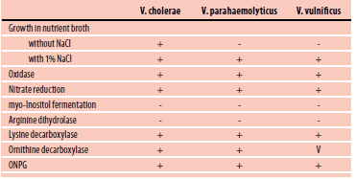
Contd..

Slide 23
Treatment
Even before identifying cause of disease, rehydration therapy must begin Immediately because death can occur within hours*
Oral rehydration
Intravenous rehydration
Antimicrobial therapy
Vaccination

Slide 24
Vibrio-Prevention and Control
Improved sanitation
Fluid and electrolyte replacement
Antibiotic prophylaxis
Improved food handling

